Slide 1
Algorithm design
Types

Slide 2
Most important type of Algorithms
Factors:
A good algorithm should be optimized in terms of time and space.
Different types of problems require different types of algorithmic techniques to be solved in the most optimized manner.
Different types of algorithms are :
Greedy algorithms [/Recursive]
Divide-and-conquer algorithms [/Recursive]
Backtracking algorithms [/Recursive]
Dynamic programming [/Recursive]
Stochastic algorithms
There are other techniques as well:
Evolutionary algorithms
Combinatorial algorithms
Distributed algorithms
Gradient methods
Brute Force Algorithm
Randomized Algorithm:

Slide 3
Different types of algorithms are :
Greedy algorithms [/Recursive]
Divide-and-conquer algorithms [/Recursive]
Backtracking algorithms [/Recursive]
Dynamic programming [/Recursive]
Stochastic algorithms
There are other techniques not covered in this course:
Evolutionary algorithms
Combinatorial algorithms
Distributed algorithms
Gradient methods
Brute Force Algorithm
Randomized Algorithm:
Greedy Algorithm
Greedy is an algorithmic paradigm that builds up a solution piece by piece, always choosing the next piece that offers the most obvious and immediate benefit.
So, the problems were chosen locally optimal also leads to global solution are the best fit for Greedy.
Greedy Problems on Graph:
Kruskal’s Minimum Spanning Tree
Prim’s Minimum Spanning Tree
Dijkastra’s Shortest Path Algorithm
Minimum cost to connect all cities
Huffman encoding
Number of single cycle components in an undirected graph
Approximate Greedy Algorithm for NP Complete:
Bin Packing Problem
Graph Coloring
Travelling Salesman Problem using MST

Slide 4
Different types of algorithms are :
Greedy algorithms [/Recursive]
Divide-and-conquer algorithms [/Recursive]
Backtracking algorithms [/Recursive]
Dynamic programming [/Recursive]
Stochastic algorithms
There are other techniques not covered in this course:
Evolutionary algorithms
Combinatorial algorithms
Distributed algorithms
Gradient methods
Brute Force Algorithm
Randomized Algorithm:
Limitations of Greedy Algorithm
The greedy algorithm makes judgments based on the information at each iteration without considering the broader problem; hence it does not produce the best answer for every problem.
The problematic part for a greedy algorithm is analyzing its accuracy. Even with the proper solution, it is difficult to demonstrate why it is accurate.
Optimization problems (Dijkstra’s Algorithm) with negative graph edges cannot be solved using a greedy algorithm.
When to use :
For example, you can greedily approach your life. You can always take the path that maximizes your happiness today. But that doesn't mean you'll be happier tomorrow.
Similarly, there are problems for which greedy algorithms don't yield the best solution. When you don’t need guarantee of an optimal solution.

Slide 5
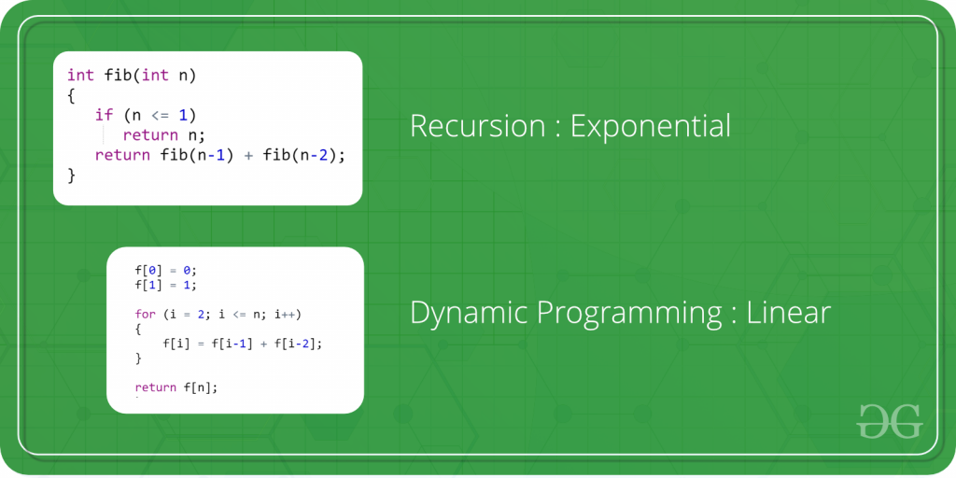
Different types of algorithms are :
Greedy algorithms [/Recursive]
Divide-and-conquer algorithms [/Recursive]
Backtracking algorithms [/Recursive]
Dynamic programming [/Recursive]
Stochastic algorithms
There are other techniques not covered in this course:
Evolutionary algorithms
Combinatorial algorithms
Distributed algorithms
Gradient methods
Brute Force Algorithm
Randomized Algorithm:
Dynamic programming
Dynamic Programming is mainly an optimization over plain recursion. Wherever we see a recursive solution that has repeated calls for same inputs, we can optimize it using Dynamic Programming.
The idea is to simply store the results of subproblems, so that we do not have to re-compute them when needed later. This simple optimization reduces time complexities from exponential to polynomial.
Dynamic programming :
Floyd Warshall Algorithm
0-1 Knapsack Problem
Vertex Cover Problem
Travelling Salesman Problem
Recursion : exponential
Dynamic programming: Linear

Slide 6
Different types of algorithms are :
Greedy algorithms [/Recursive]
Divide-and-conquer algorithms [/Recursive]
Backtracking algorithms [/Recursive]
Dynamic programming [/Recursive]
Stochastic algorithms
There are other techniques not covered in this course:
Evolutionary algorithms
Combinatorial algorithms
Distributed algorithms
Gradient methods
Brute Force Algorithm
Randomized Algorithm:
Stochastic algorithms
In real life, many unpredictable external events can put us into unforeseen situations. Many games mirror this unpredictability by including a random element, such as the throwing of dice. We call these stochastic games.
Stochastic refers to a variable process where the outcome involves some randomness and has some uncertainty. It is a mathematical term and is closely related to “randomness” and “probabilistic” and can be contrasted to the idea of “deterministic.”
Advantages:
Speed: Faster than other variants of Gradient Descent such as Batch Gradient Descent and Mini-Batch Gradient Descent.
Memory Efficiency: Since SGD updates the parameters for each training example one at a time, it is memory-efficient and can handle large datasets that cannot fit into memory.
Avoidance of Local Minima: Due to the noisy updates in SGD, it has the ability to escape from local minima and converge to a global minimum.
Disadvantages:
Noisy updates: The updates in SGD are noisy and have a high variance, which can make the optimization process less stable and lead to oscillations around the minimum.
Some examples of stochastic optimization algorithms include:
Iterated Local Search
Stochastic Gradient Descent
Genetic Algorithm
Differential Evolution
Particle Swarm Optimization

Slide 7
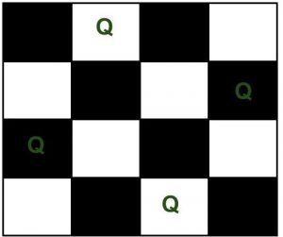
Different types of algorithms are :
Greedy algorithms [/Recursive]
Divide-and-conquer algorithms [/Recursive]
Backtracking algorithms [/Recursive]
Dynamic programming [/Recursive]
Stochastic algorithms
There are other techniques not covered in this course:
Evolutionary algorithms
Combinatorial algorithms
Distributed algorithms
Gradient methods
Brute Force Algorithm
Randomized Algorithm:
Backtracking algorithms
Backtracking can be defined as a general algorithmic technique that considers searching every possible combination in order to solve a computational problem.
There are three types of problems in backtracking –
Decision Problem – In this, we search for a feasible solution.
Optimization Problem – In this, we search for the best solution.
Enumeration Problem – In this, we find all feasible solutions.
Some examples of Backtracking algorithms are:
Generate k-ary Strings
Graph Coloring Problem
Hamiltonian Cycles
N-Queens Problem
Knapsack Problem
N-Queen Problem

Slide 8
Different types of algorithms are :
Greedy algorithms [/Recursive]
Divide-and-conquer algorithms [/Recursive]
Backtracking algorithms [/Recursive]
Dynamic programming [/Recursive]
Stochastic algorithms
There are other techniques not covered in this course:
Evolutionary algorithms
Combinatorial algorithms
Distributed algorithms
Gradient methods
Brute Force Algorithm
Randomized Algorithm:
Backtracking algorithms
Backtracking approach is used to solve complex combinatorial problems which cannot be solved by exhaustive search algorithms.
Difference between Backtracking and Recursion
Sl. No. | Recursion | Backtracking
1 | Recursion does not always need backtracking | Backtracking always uses recursion to solve problems
2 | A recursive function solves a particular problem by calling a copy of itself and solving smaller subproblems of the original problems. | Backtracking at every step eliminates those choices that cannot give us the solution and proceeds to those choices that have the potential of taking us to the solution.
3 | Recursion is a part of backtracking itself and it is simpler to write. | Backtracking is comparatively complex to implement.
4 | Applications of recursion are Tree and Graph Traversal, Towers of Hanoi, Divide and Conquer Algorithms, Merge Sort, Quick Sort, and Binary Search. | Application of Backtracking is N Queen problem, Rat in a Maze problem, Knight’s Tour Problem, Sudoku solver, and Graph coloring problems.

Slide 9
Different types of algorithms are :
Greedy algorithms [/Recursive]
Divide-and-conquer algorithms [/Recursive]
Backtracking algorithms [/Recursive]
Dynamic programming [/Recursive]
Stochastic algorithms
There are other techniques not covered in this course:
Evolutionary algorithms
Combinatorial algorithms
Distributed algorithms
Gradient methods
Brute Force Algorithm
Randomized Algorithm
Divide-and-conquer algorithms
This technique can be divided into the following three parts:
Divide: This involves dividing the problem into smaller sub-problems.
Conquer: Solve sub-problems by calling recursively until solved.
Combine: Combine the sub-problems to get the final solution of the whole problem.
Advantages of Divide and Conquer Algorithm:
It is easy to implement and understand.
It reduces the time complexity of the algorithm by breaking down the problem into smaller sub-problems.
It can be used to solve a wide range of problems, including sorting, searching, and optimization.
It can be used in parallel computing to improve performance
Some examples of DC are:
Binary Search
Merge Sort and Quicksort
Min and Max finding
Closest Pair problem
Disadvantages of Divide and Conquer Algorithm:
It can be difficult to determine the base case or stopping condition for the recursive calls.
It may not be the most efficient algorithm for all problems.
It may require more memory than other algorithms because it involves storing intermediate results.

Slide 10
Other types
Evolutionary algorithms
Combinatorial algorithms
Distributed algorithms
Gradient methods
Brute Force Algorithm
Randomized Algorithm

Slide 11
Brute Force Algorithm
A brute force approach is an approach that finds all the possible solutions to find a satisfactory solution to a given problem. The brute force algorithm tries out all the possibilities till a satisfactory solution is not found.
PROS AND CONS OF BRUTE FORCE ALGORITHM:
Pros:
The brute force approach is a guaranteed way to find the correct solution by listing all the possible candidate solutions for the problem.
It is a generic method and not limited to any specific domain of problems.
The brute force method is ideal for solving small and simpler problems.
It is known for its simplicity and can serve as a comparison benchmark.
Cons:
The brute force approach is inefficient. For real-time problems, algorithm analysis often goes above the O(N!) order of growth.
This method relies more on compromising the power of a computer system for solving a problem than on a good algorithm design.
Brute force algorithms are slow.
Brute force algorithms are not constructive or creative compared to algorithms that are constructed using some other design paradigms.

